Slide 1
I want to talk about a wonderful book «Vasya Kurolesov’s adventures».

Slide 2
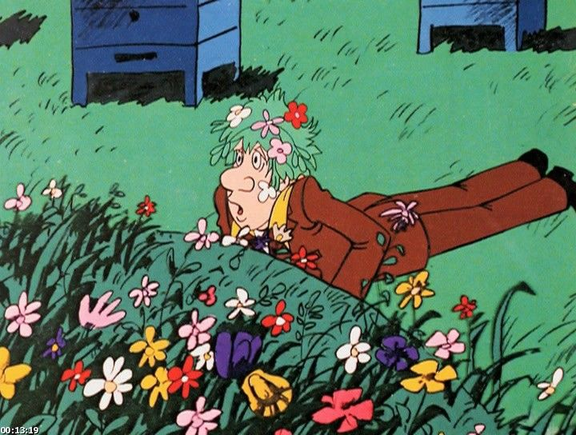
This book is about the adventures of a boy named Vasya.

Slide 3
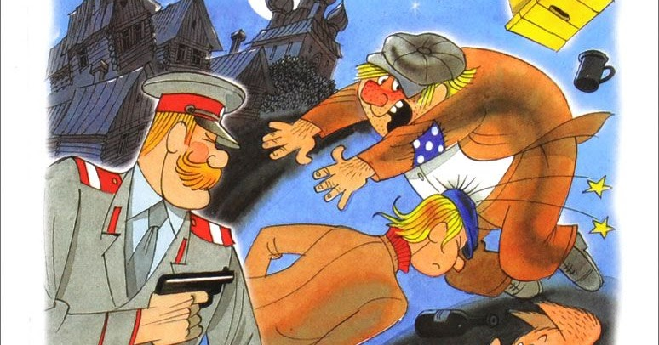
This is a very funny and interesting book.

Slide 4
I recommend this book to those who learn the Russian language.

Slide 5
Thank you for attention!

