Slide 1
Largest Worlds Brands Prepared by Egor Belyaev, 9 «G» class. Teacher: Cagle.V.N. Gymnasium №23

Slide 2
To show the most popular and significant brands in the world. To tell about their history and value.

Slide 3
What Is The Brand ?
A brand is the way a company, organization, or individual is perceived by those who experience it. More than simply a name, term, design, or symbol, a brand is the recognizable feeling a product or business evokes.
Brands, then, live in the mind. They live in the minds of everyone who experiences them: employees, investors, the media, and, perhaps most importantly, customers.
Simply put, brands are perceptions.

Slide 4
The Importance Of Brands
Every day we can see million of brands. They are everywhere, but sometimes we don’t pay attention to it. Everything that surrounds us has it’s own brand. When I say everything, I mean absolutely everything. For example, can anyone name at least one thing in their room that doesn’t have a brand?-I can’t. That’s why we need to learn more about brands, because its an integral part of our life.

Slide 5
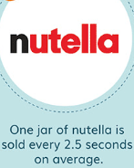
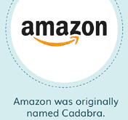
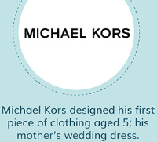
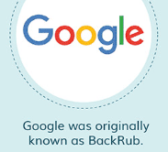
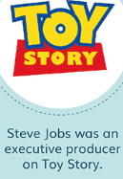
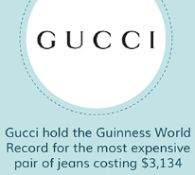
Some Surprising Facts About World’s Brands
x

Slide 6
The Biggest Brand In The World
Apple is the most influential brand and the most expensive company in the world. It based in Cupertino, California. The founders are Steve Jobs, Steve Wozniak and Royal Wayne. As we know the company designs and manufactures hardware products: IPhone, IPod, MacBook etc. The market cap is about 1,38 trillion dollars. It employs a total of 60k full time employees. To be honest apple products are so overpriced but anyway everybody buy it.

Slide 7
The Second Biggest Brand In The World
Google, was beaten to the top spot but clearly showed its dominance among the world's household names, as it had the second-highest brand strength. Its parent company, Alphabet, has a market cap of $932 billion. Google is an American multinational technology organization that specializes in Internet-related services and products, which include online advertising technologies, search engine, cloud computing, hardware and software. It is considered one of the Big Four technology companies, alongside Amazon, Apple, and Facebook. Google has the best reputation of any company in US and id one of the most recognized brands.

Slide 8
The Third Biggest Brand In The World
Unfortunately amazon is not available in Russia and we cannot experience all the charms of this service. Amazon an American multinational technology firm based in Seattle, Washington. The focus is on e-commerce, cloud computing, artificial intelligence, and digital streaming. He is considered one of the Big Four technology companies along with Google, Apple and Facebook. He is on the list of the best global brands. Millennials (Millennials, or Generation Y, is a generation of people born from 1981 to 1996.) love Amazon more than any other brand.

Slide 9
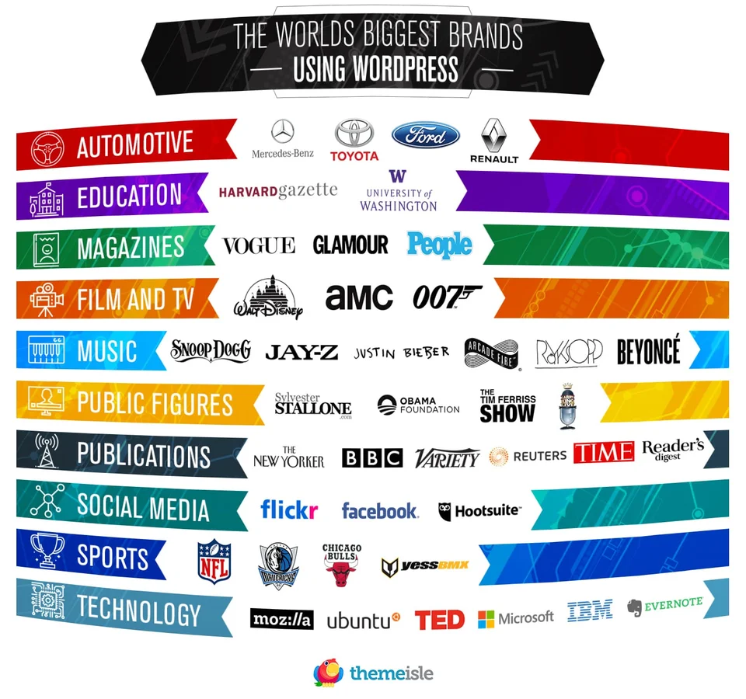

Slide 10
The Most Valuable Clothing Brand
World’s most expensive brand is Louis Vuitton. The brand value of this company has reached about $28.1 Billion. Louis Vuitton is very well known for its use of leather, excellent tailoring of trench coats, ready to wear dresses, shoes, accessories, watches, sunglasses, jewelry, books and many other accessories, and deservingly have taken the 1st position in the list. Bags of this brand can cost 10,000 euros and this is far from the most expensive exemplar. LV skin is known all over the world and immediately catches your eye

Slide 11
The Influence Of Brands On Our Life
Affects on preference of consumers.
Choose the way of the innovation.
The largest international companies have a lot of impact on development of economy.
Marketing of companies often affect on people’s minds and impose stereotypes.

Slide 12
Conclusion
In this project I tried to gather the information about history and value of the most influential brands.
All brands and companies play a significant role in our culture and have a great impact on international relations.

Slide 13
Thanks for your attention

Slide 14
Source:
https://www.forbes.com/powerful-brands/list/#tab:rank
https://cordmagazine.com/fashion/top-ten-best-selling-clothing-fashion-brands-in-the-world/
https://www.brandpedia.ru/brand-613.html
http://www.ignytebrands.com/what-is-a-brand/
https://brandirectory.com/rankings/apparel/2018/table
https://brandirectory.com/rankings/apparel/table

